Slide 1

Module I:
FIGHTING BACK AGAINST SCAMS AND IDENTITY THEFT

Slide 2
Goals:
Encourage open dialogue around scams that are targeted toward consumers in Georgia;
Present compelling reasons to participants to put a credit freeze on their accounts for all three credit reporting agencies;
Encourage parents and guardians to place a credit freeze on their children’s accounts;
Help participants identify red flags found in phone calls, emails or text messages that indicate unscrupulous practices they should avoid;
Help participants avoid products and services that, while legal, may be predatory in nature;
Present compelling reasons to participants to put a credit freeze on their accounts for all three credit reporting agencies;

Slide 3
Goals:
Help participants identify red flags found in phone calls, emails or text messages that indicate unscrupulous practices they should avoid;
Help participants understand and sign-up for the FTC ‘Do Not Call Registry’;
Encourage participants to utilize the ‘opt-out pre-screen’ option from the three major credit reporting agencies;
Encourage participants to check their credit reports at least twice per year;
And, present compelling reasons to participants for reporting suspected scams and cases of identity theft to the appropriate state and federal agencies.

Slide 4

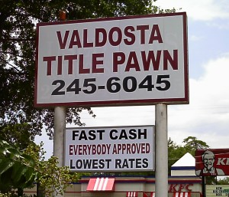


Consumer Finance Concerns in the Georgia Marketplace
Payday Lending
Title Pawn
Prepaid Cards
Binding Arbitration
Debt Collection
Credit Repair
Homebuyers
Notes:
Begin with anecdote about Western Sky Financial—she looks friendly, $10,000 seems great! What’s the problem? Fine print says you will, typically, make 84 monthly payments of $743.99. That is over $60,000 for taking out $10k! Payday lending was banned in 2004, but there are still online lenders and it is legal in Alabama, Florida, Tennessee and South Carolina. There are also roughly 16 payday lenders on the road from Phenix, Alabama to Fort Benning, GA.

Slide 5
Payday Lending
Banned in Georgia in 2004
Initial Loan:
$10,000
What You Really Owe:
84 monthly payments
X
$743.99
=
$62,495.16
Notes:
Begin with anecdote about Western Sky Financial—she looks friendly, $10,000 seems great! What’s the problem? Fine print says you will, typically, make 84 monthly payments of $743.99. That is over $60,000 for taking out $10k! Payday lending was banned in 2004, but there are still online lenders and it is legal in Alabama, Florida, Tennessee and South Carolina. There are also roughly 16 payday lenders on the road from Phenix, Alabama to Fort Benning, GA.

Slide 6
Title Pawn
Study in 2012 found that only 10% of borrowers had their car repossessed (GA, ID, TX)
State Law Caps:
  25% monthly for first 3 months
  12.5% monthly after that
  This means a combined maximum yearly interest rate of 187.5%
Notes:
Title pawn is still very much legal. Also very prevalent around military installations, with the most in Chatham County where Savannah is. We have many in the Marietta area where the car dealerships are. The main issue surprisingly is not repossession of the vehicle, but consumers being stuck making payments for multiple years, often paying more in interest than the car was worth in the first place.

Slide 7
Pay Day & Title Pawn Lending Prevention
Use alternatives:
  Look for the lowest interest rate from a bank or credit union.
  Consider a loan from family or friends.
  Ask your present creditors about reducing your interest rate.
  Maintain a bank account with overdraft protection.
  Make a budget.
  If you need help with a budget or see no way to pay your bills, consult a legitimate consumer credit counseling service.
Consumer Credit Counseling
  ClearPoint State Wide: 1-800-750-2227
  National Foundation for Credit Counseling at www.nfcc.org or the Association of Independent Credit Counseling Agencies at www.aiccca.org

Slide 8

Pay Day Lending: Resolution
If the loan was legally issued:
  Unexpected fees, lender disappears, or other issues may occur.
  Submit complaint to Consumer Financial Protection Bureau (CFPB)
    1-855-411-2372
    http://www.consumerfinance.gov/complaint/
If the loan was illegal to begin with:
  Contact Attorney General Sam Olens:
  (404) 656-3300

Slide 9
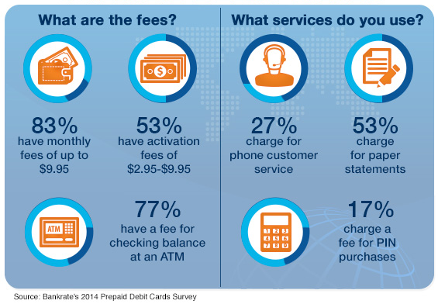
Prepaid Cards

Slide 10
Binding Arbitration: Cons
Arbitration costs more than filing a claim in court.
Unlike a court ruling, a binding arbitration ruling can't be appealed.
Lack of transparency—everything happens behind closed doors.
Objectivity is questionable.
Many will exclude you from class action suits in the future.

Slide 11
Binding Arbitration in Georgia
Legal
Illegal
Employment
Home Building
Car Loans & Leases
Service Contracts (Cell Phone, Cable, Utilities)
Online Agreements (iTunes, Netflix, PayPal)
Credit Cards
Retirement Accounts
Investment Accounts
Checking Accounts
Nursing Facilities
Contracts for the Purchase of Consumer Goods (for example, cars)
Insurance Contracts
Provisions Relating to Injuries Resulting from Medical Care (medical malpractice)
Provisions Relating to Personal Bodily Injury or Wrongful Death Based on Tort
Loan Agreements in which the Amount of Indebtedness is $25,000 or Less at the Time of Execution

Slide 12
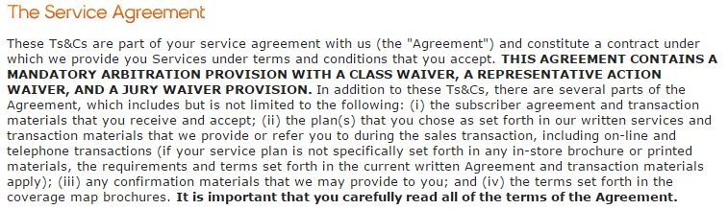

Example: Boost Mobile Contract

Slide 13
Top Complaints in Georgia (2014 and 2015)
Scam Type | Number - 14 | Percent -14 | Number - 15 | Percent - 15 | % Change
Debt Collection | 13,816 | 18% | 65,585 | 53% | +35%
Telephone and Mobile Scams | 8,848 | 11% | 15,483 | 13% | +2%
Imposter Scams | 5,172 | 7% | 8,000 | 6% | -1%
Banks and Lenders | 4,981 | 6% | 5,473 | 4% | -2%
Auto-Related Complaints | 3,217 | 4% | 3,785 | 4% | 0%
Prizes, Sweepstakes, and Lotteries | 2,549 | 3% | 4,608 | 3% | 0%
Television and Electronic Media | 2,406 | 3% | 2,420 | 2% | -1%
Shop-at-Home and Catalogue Sales | 1,646 | 2% | 2,460 | 2% | 0%
Credit Bureaus, Information Furnishers and Report Users | 1,386 | 2% | 2,080 | 2% | 0%
Health Care | 1,201 | 2% | n/a | n/a | n/a
Credit Cards | n/a | n/a | 1,350 | 1% | n/a
TOTAL | 89,910 | n/a | 123,429 | n/a | +37.3%
Source: Federal Trade Commission
Notes:
Florida, Georgia and Nevada are the top three states for fraud per capita and other complaints; and these are just the ones we hear about! As we discussed, seniors especially are less likely to report issues, and the general population will not report an incident if they were not actually taken advantage of. We encourage everyone to report any suspicious call they receive or email that might be from a scammer, so we can stop them from taking advantage of less prepared folks in our communities!

Slide 14
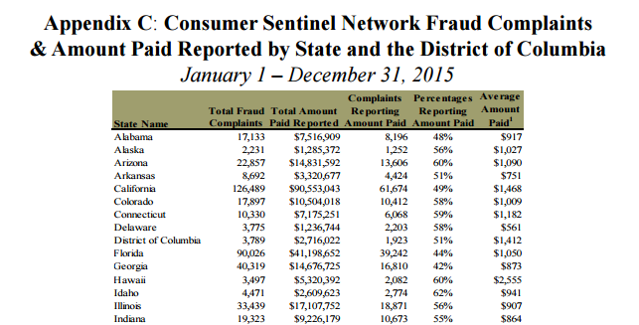
Reported Payouts in Georgia Fraud Cases

Slide 15
Debt Collection: Case Study
CFPB v Hanna
  High volume of debt collection suits against Georgia consumers who allegedly owed money to credit-card issuers.
  Attorneys of this firm typically spend less than one minute reviewing each consumer case before filing an action in court.
  From 2009 to 2013, Hanna & Associates filed more than 350,000 collection suits against Georgia consumers. During those years, the firm only staffed somewhere between 8 to 16 attorneys, with most of the work done by automated systems and paralegals.
  In 2009 and 2010, the firm directed one attorney to sign about 138,000 lawsuits, an average of 1,300 collection suits per week.
Notes:
Florida, Georgia and Nevada are the top three states for fraud per capita and other complaints; and these are just the ones we hear about! As we discussed, seniors especially are less likely to report issues, and the general population will not report an incident if they were not actually taken advantage of. We encourage everyone to report any suspicious call they receive or email that might be from a scammer, so we can stop them from taking advantage of less prepared folks in our communities!

Slide 16
Debt Collection: Know Your Rights
The statute of limitations (time limit) for when credit card debt collectors can attempt to recover credit card debt in Georgia is 6 years.
The Fair Debt Collection Practices Act protects consumers from harassment:
  Repeated phone calls intended to annoy, abuse, or harass
  Obscene or profane language
  Threats of violence or harm
  Publishing lists of people who refuse to pay their debts
  Calling you without telling you who they are
  Using false, deceptive, or misleading practices
Reporting: Federal Trade Commission or the Attorney General’s Office
Notes:
Florida, Georgia and Nevada are the top three states for fraud per capita and other complaints; and these are just the ones we hear about! As we discussed, seniors especially are less likely to report issues, and the general population will not report an incident if they were not actually taken advantage of. We encourage everyone to report any suspicious call they receive or email that might be from a scammer, so we can stop them from taking advantage of less prepared folks in our communities!

Slide 17
Tax Fraud Prevention
Everyone should file a tax return. Everyone.
Know how the IRS will contact you and request payment.
Keep personal documents locked away and shred old documents.
Choose a reliable tax preparer:
    AARP Tax Aid Program (all ages; no income limit)
    IRS VITA Sites (up to $54,000)
    Higher Income/Complex Return: Find a CPA with experience
Notes:
Who should file? We think everyone should. Tax filing threshold for an individual is $10,000, but everyone is at risk for having their social stolen and used to file a faulty tax return. It doesn’t matter how much you make, the scammers will make up fake income for you to get your income.
The IRS will ONLY contact you via mail for payments or refunds. If you signed up through a tax preparer, they might email you updates, but not the IRS.

Slide 18
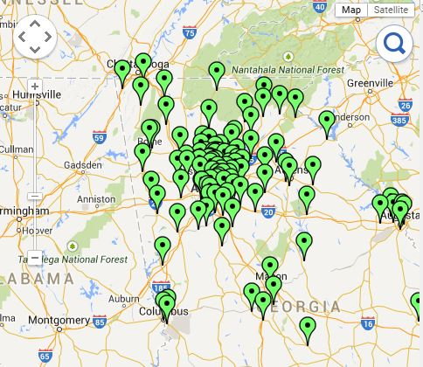
Free & Reliable
Tax Prep Map
www.georgiawatch.org/taxmap
Hours
Locations
Appointment Information
Eligibility
Notes:
AARP is free for anyone, regardless of income. VITA is for anyone with income below $53,000.

Slide 19
Report Tax Fraud
File complaint with the IRS
  1-800-908-4490
Georgia Department of Revenue
  1-877-423-6711
Identity theft involved? Get assistance from the Federal Trade Commission:
  1-877-FTC-HELP (1-877-382-4357)

Slide 20
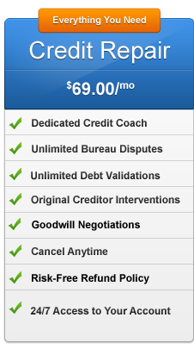
How Does Credit Repair Work?
Beware if they:
Want you to pay for credit repair services before any services are provided
Do not tell you your legal rights and what you can do yourself – for free
Recommend that you not contact a consumer reporting company directly
Suggest that you try to invent a “new” credit report by applying for an EIN to use instead of your SSN
Advise you to dispute all information in your credit report or take any action that seems illegal

Slide 21
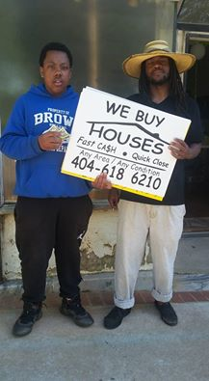
“We Buy Houses”
“So yall pay $$ fast? Well so do the neighbors in Ashview Heights! Youth get $2 a sign. Youth get paid every Saturday to keep these signs down! Simple and communal solutions. Youth engagement × Youth Employment × Keeping homes in hands!”

Slide 22
Pick 4…
Realistically, you can get through 4 out of the 7 topics provided in this section if you are also covering identity theft prevention in your 60 minute presentation.
Choose the 4 that are most present in your community.

Slide 23

IDENTITY THEFT
Preventing:

Slide 24
Georgia Identity Theft Complaints (2015)
Identity Theft Type | Complaints | Percentage
Government Documents or Benefits Fraud | 6,494 | 43%
Credit Card Fraud | 2,519 | 17%
Phone or Utilities Fraud | 2,021 | 13%
Bank Fraud | 1,017 | 7%
Loan Fraud | 703 | 5%
Employment-related Fraud | 305 | 2%
Other | 3,356 | 22%
Attempted Identity Theft | 539 | 4%
TOTAL | 15,230 | n/a
Source: Federal Trade Commission

Slide 25
What Do Identity Thieves Want?
Social Security number
Date of birth
Address
Telephone number
Driver’s license
Account numbers
Credit cards and numbers
Pins and passwords
Mother’s maiden name
Financial records
Email address

Slide 26
How Do Identity Thieves Get Your info?
Directly from you
Family member
“Dumpster-diver” or your mailbox
Phishing and pre-texting
Bogus Job Offers
Fake Sweepstakes or Lotteries
Working In Your Home
Changing Your Address
Shoulder surfing
Social Network Websites
File Sharing or Peer-to-Peer Software
Large-scale commercial data breaches
Reading RFID
Medical Identity Theft
Maybe someone you do business with

Slide 27
Preventing Identity Theft
When you receive a shady call, email or text, HANG UP AND REPORT:
  Phone: 1 (877) FTC-HELP (1-877-382-4357)
  Online: https://www.ftccomplaintassistant.gov
Freeze your credit.
Limit using personal information online.
Use a different, unique, password for every account.
Keep personal information safe & secure.
Get bank & credit card alerts sent to your phone.
  Sign up for “Opt-Out-Prescreen” at no charge.
    www.optoutprescreen.com or by calling 1-888-567-8688
Add yourself to the “Do not call” registry.
  www.donotcall.gov or 1-888-382-1222 (TTY: 1-866-290-4236)
Notes:
Pass out credit freeze worksheet

Slide 28
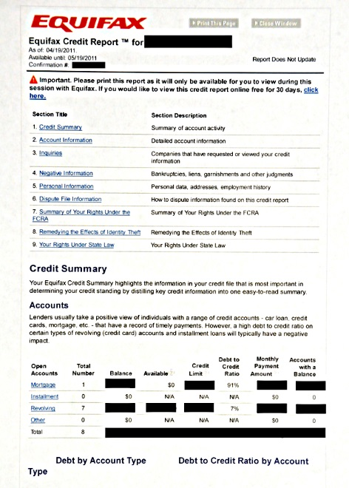
Protection
Monitor Your Credit Report
Equifax — 1‑800‑525‑6285
Experian —1‑888‑397‑3742
TransUnion — 1‑800‑680‑7289
At least TWICE PER YEAR.
ALL THREE AGENCIES.
REPORT ANY ERRORS.
www.annualcreditreport.com
Notes:
You’re entitled to receive a free copy of your credit report from each of the credit bureaus at least once a year. You give yourself the best chance to not be victimized if you monitor your credit report consistently.
To obtain a copy of your credit report from Equifax, you’ll need to call 1-800-685-1111.
To get a copy from Experian, you’ll need to dial 1-888-397-3742.
The telephone number for Transunion is 1-800-916-8800.
You can also get a free copy of your credit report from www.annualcreditreport.com.
Identity theft is so commonplace now that you cannot assume you will never become a victim. By being proactive, you can take control of your personal information and make sure you’re doing everything possible to protect your identity.
28

Slide 29
Credit scores:
Example based on FICO score
These percentages reflect how much each category determines a typical FICO score.
Notes:
ACTIVITY #13: Understanding Credit Reports and Scores CONTINUED
Presentation (Module 12, Page 208)
Note: Only present this information if you have time.
Use the following information from Page 208 of the Toolkit to explain the composition of the FICO Score.
“Payment history” tracks whether you are paying your bills on time and as agreed. This is the biggest factor in your FICO Scores.
Paying bills late, not paying bills at all, and having bills that go to collections will cause your scores to drop.
The older this information is, the less impact it has on your scores.
This is the reason is it more important to stay current with active accounts than it is to pay off old debts. Debts that have gone to collections have already damaged your scores.
“Amounts owed” includes whether you are paying down your loan balances as agreed.
It also includes your credit utilization rate. Your credit utilization rate is how much of your available credit you are using.
If you use more than 30% of your credit limits, your scores may drop.
“Length of credit history” is the next factor that impacts your scores. Your score increases the longer you have a credit history.
“New credit” tracks your inquiries. If you have too many inquiries, the model interprets this to mean you have a high demand for credit, which may be an indicator of risk, and your scores may drop.
When you are shopping for a loan, however, most models give you a window of time when multiple inquiries can be made for some types of credit without causing your score to drop.
Finally, “types of credit used” is considered.
Your FICO scores increase if you have both credit cards (revolving credit) and loans (installment credit such as a mortgage or car loan).
Generally, it is considered a positive to have a mortgage, an auto loan, and not too many credit cards.
Source: FICO. www.myfico.com.

Slide 30
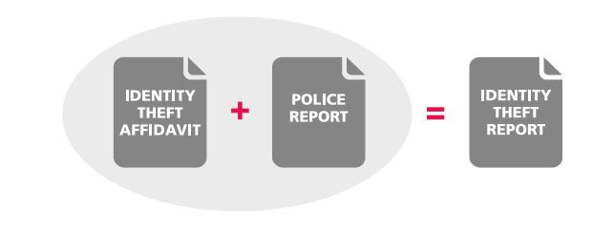
If Your Identity Has Been Stolen:
Immediate next steps:
  Place an initial fraud alerts
  Order your credit reports
  Create an identity theft report
Equifax — 1‑800‑525‑6285
Experian —1‑888‑397‑3742
TransUnion — 1‑800‑680‑7289
Notes:
If your identity is stolen, you need to place initial fraud alerts on your accounts, order credit reports and make an identity theft report, which is your statement of what occurred and the police report.

Slide 31
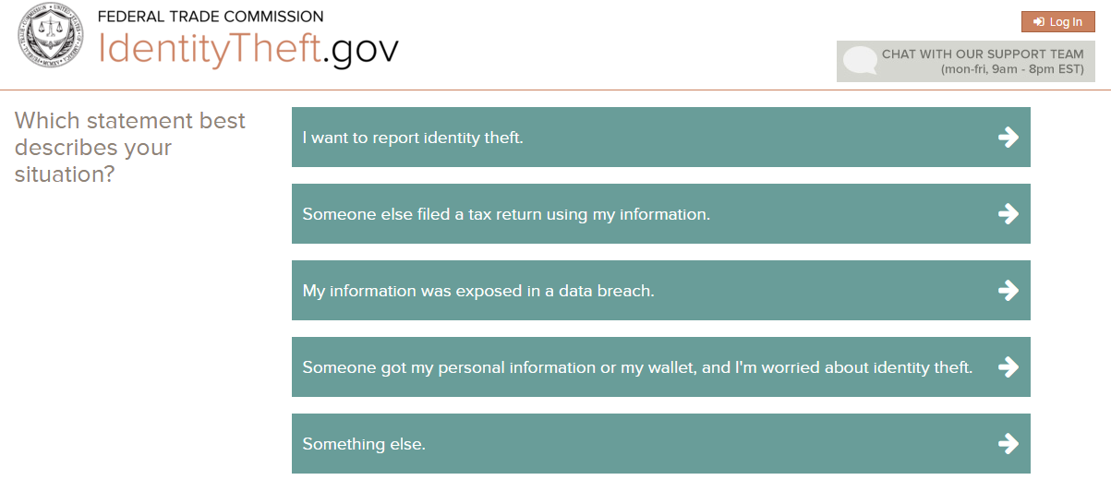
Source: https://identitytheft.gov/Know-Your-Rights

Slide 32
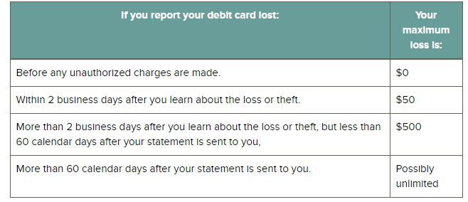
How much could you lose?
Source: https://identitytheft.gov/Know-Your-Rights

Slide 33
Your Rights:
create an identity theft report
place a 90-day initial fraud alert on your credit report
place a seven-year extended fraud alert on your credit report
get free copies of your credit report
get fraudulent information removed (or "blocked") from your credit report
dispute fraudulent or inaccurate information on your credit report
stop creditors and debt collectors from reporting fraudulent accounts
get copies of documents related to the identity theft
stop a debt collector from contacting you

Slide 34

SCAMS
FIGHTING BACK AGAINST

Slide 35
Types of Scams
Something Good: You’ve won something or are eligible to get a job.
Something Bad: You will be penalized or fined for not responding or participating.
Something Emotional: Someone is in need of your help!
Notes:
Typically scams fall into three categories

Slide 36
Reporting
CFPB
FTC
Law Enforcement
Office of Consumer Protection Georgia
Banks/Credit Unions
Creditors
Involved Retailers or Companies

